Slide 1
I AM

Slide 2

WHO IS NORPLE?
Norple is an AI Bot which helps SoftWorks turn their client’s unorganized data including text, photos, audios.. etc into a meaningful concise prompt.

Slide 3

WHAT IS NORPLE?
Norple was built using HTML/ CSS/ JS as the front-end architecture, Python and FastApi as the backend, Gemini as the ai brains of the project and lastly supabase is the database and railway was used for deployment.

Slide 4
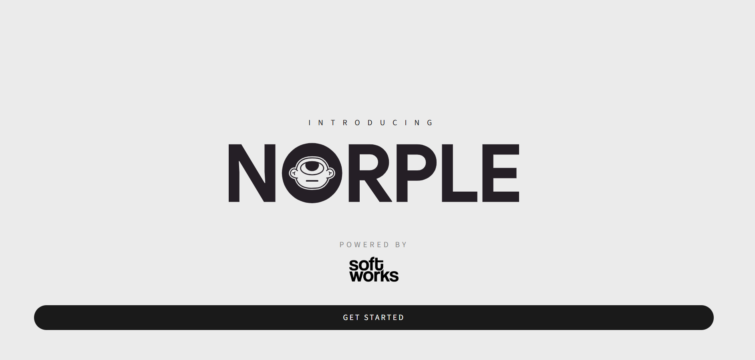
UI
HOME
SCREEN

Slide 5
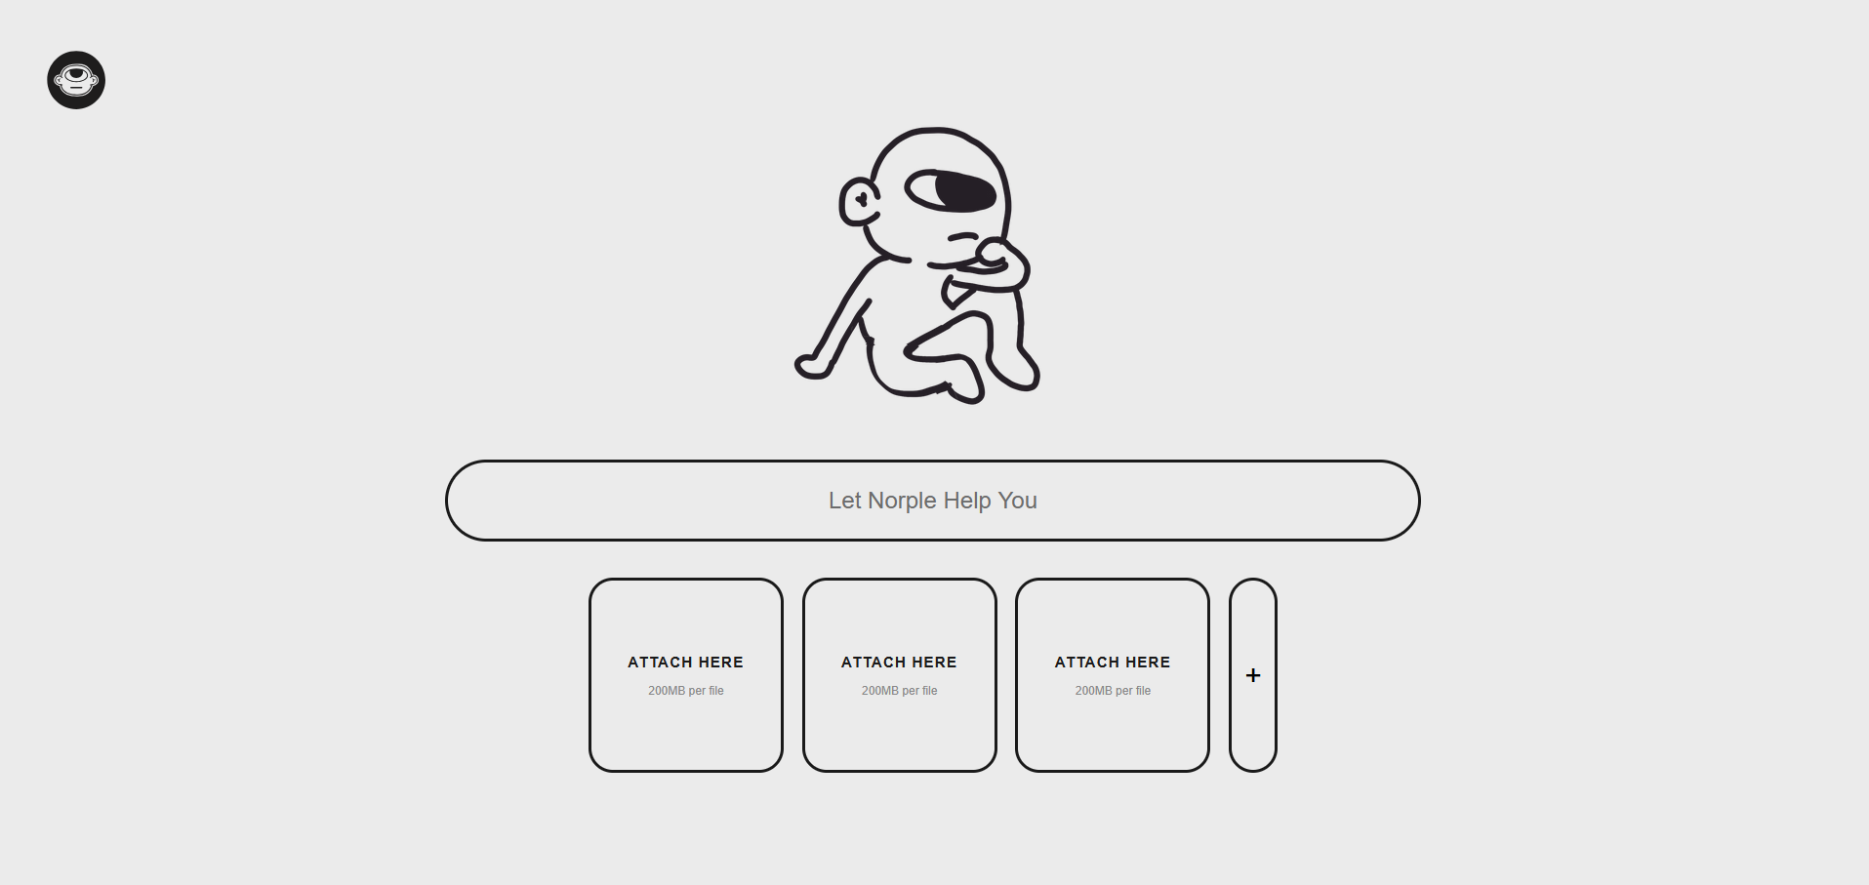
UI
BOT
SCREEN

Slide 6
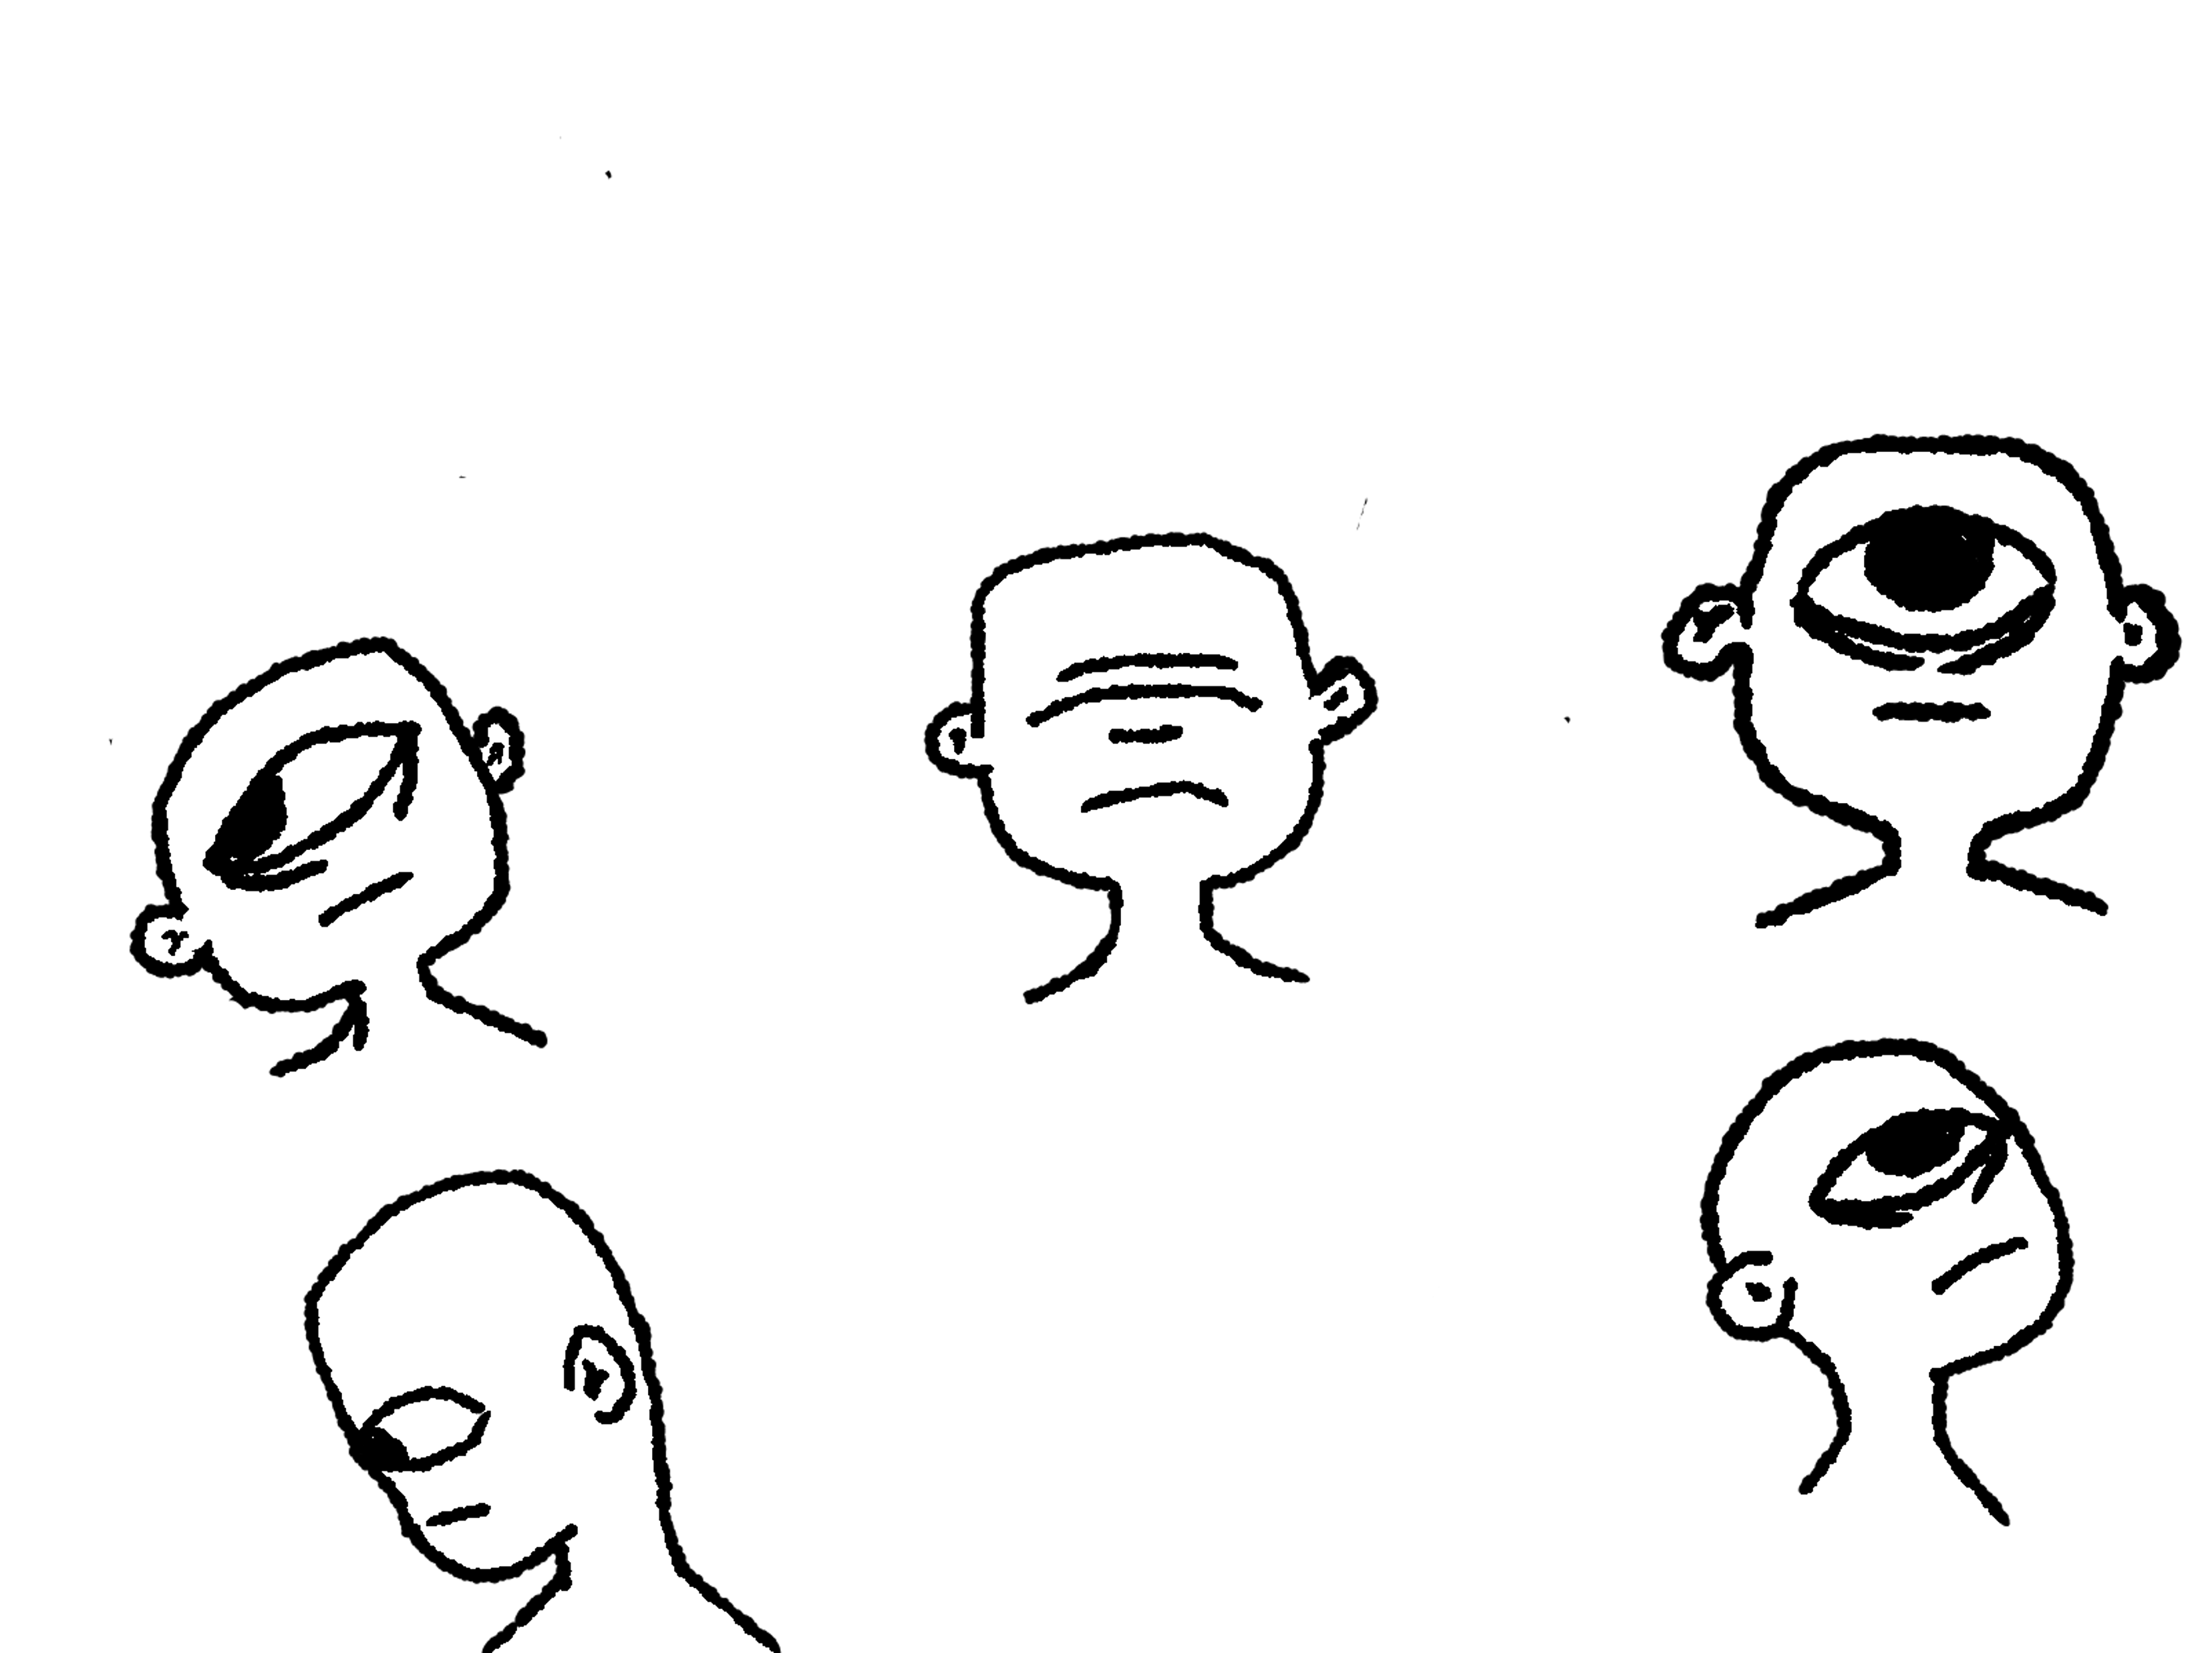
FUTURE WORKS?
Implement Further Specialization for the briefs so that they can be directed towards departments inside the client’s company

Slide 7
LOGO ICON
TYPOGRAPHY LOGO

Slide 8

SOME NORPLE SKETCHES

Slide 9
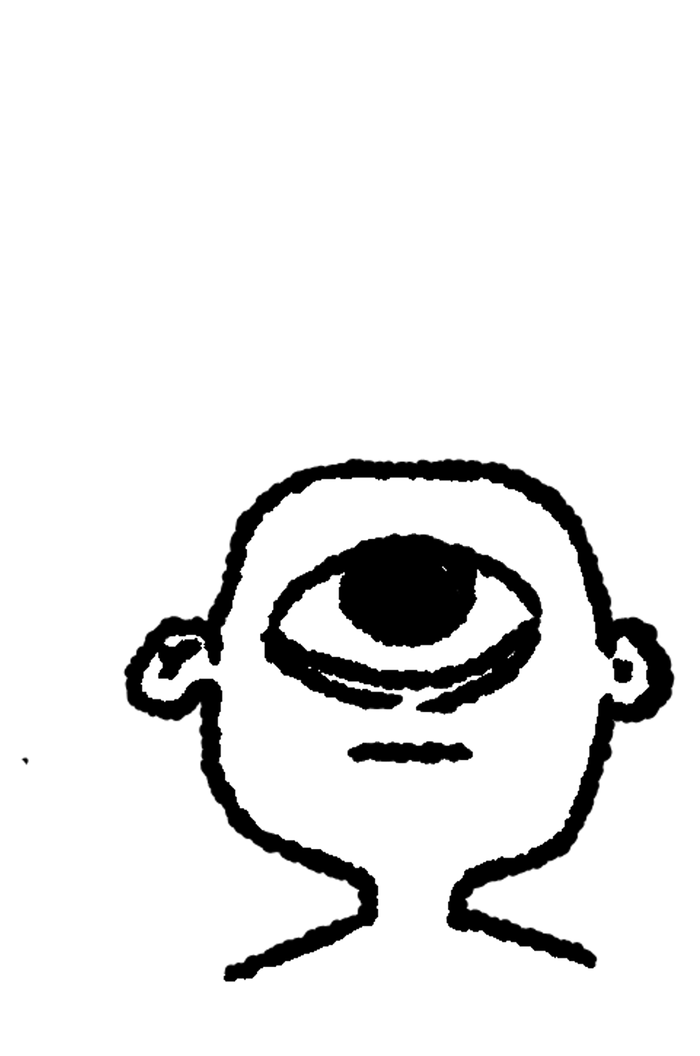
THANKS!

